Slide 1

Unlocking Airbnb Success: What Makes a Winning Listing?​

Slide 2


Unlocking Airbnb Success: What Makes a Winning Listing?
Optimizing Airbnb Success in LA: Key Strategies for Location, Hosting Approach, and Pricing to Drive Long-Term Performance
Our project, “Optimizing Airbnb Success in LA: Key Strategies for Location, Hosting Approach, and Pricing to Drive Long-Term Performance,” seeks to identify the critical factors influencing success for new Airbnb hosts in Los Angeles.
We selected this dataset because Airbnb in LA represents a dynamic intersection of real estate, economics, and consumer behaviour, providing valuable insights for potential hosts. Our approach is threefold:
Analyse the impact of location on competitive positioning and host success.
Assess how hosting strategies influence overall listing performance.
Investigate the role of pricing in balancing profitability with market appeal.
Did you know that there are over 6 million Airbnb listings worldwide, spanning more than 100,000 cities? The most unusual listing? A potato-shaped house in Idaho!

Slide 3
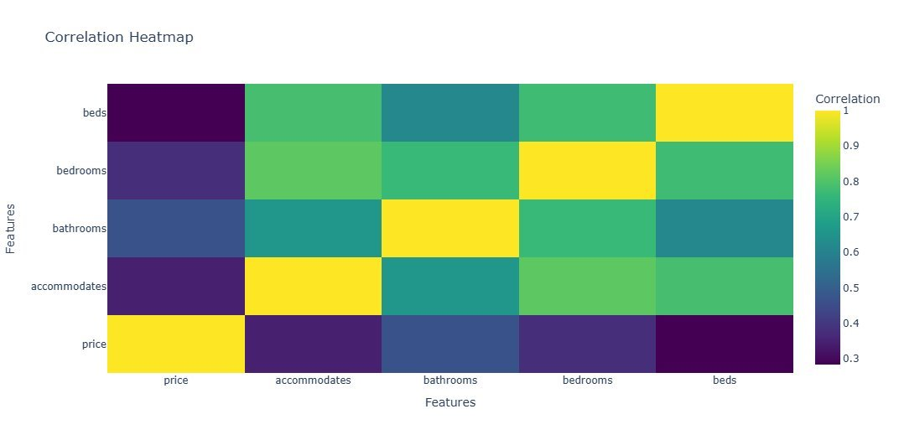
Dataset Exploration
Overview and key insights from the dataset at a glance
Physical Attributes of an Airbnb
strong positive correlations between beds, bedrooms, and bathrooms, with price showing moderate relationships to property size metrics
Other Important Variables
Location and Neighbourhood : How do neighbourhood characteristics and proximity to attractions influence property pricing and booking frequency?
Customer Ratings : What patterns emerge in guest ratings, and how do different aspects of reviews correlate with booking success?
Host history and response time : Does host experience and response speed significantly impact occupancy rates and guest satisfaction scores?

Slide 4
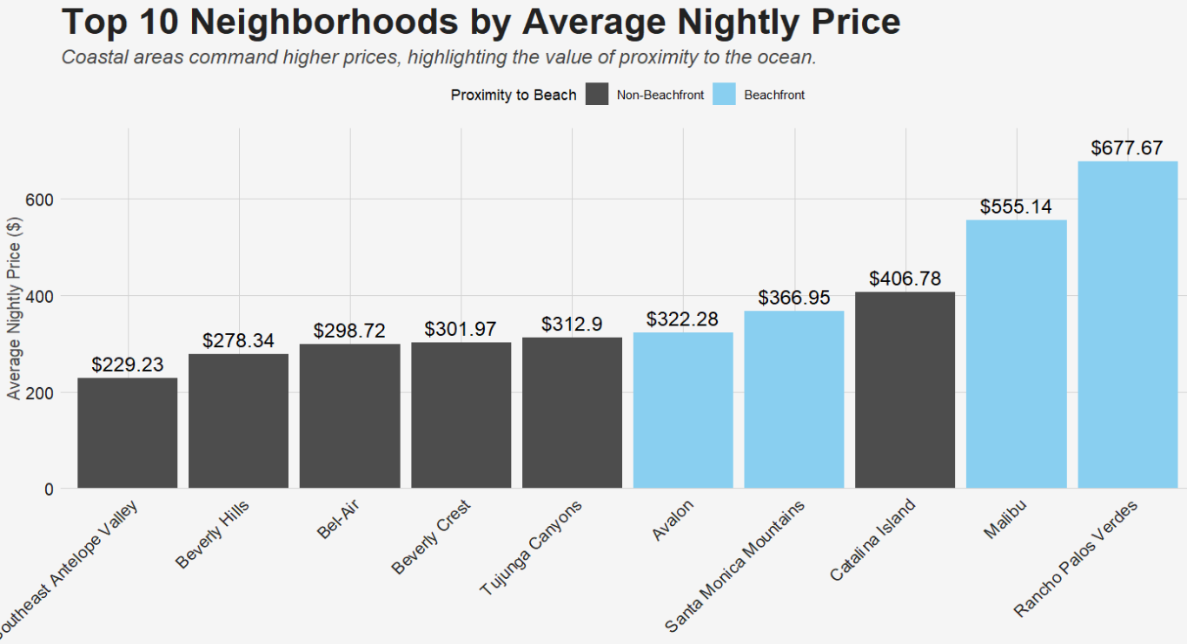
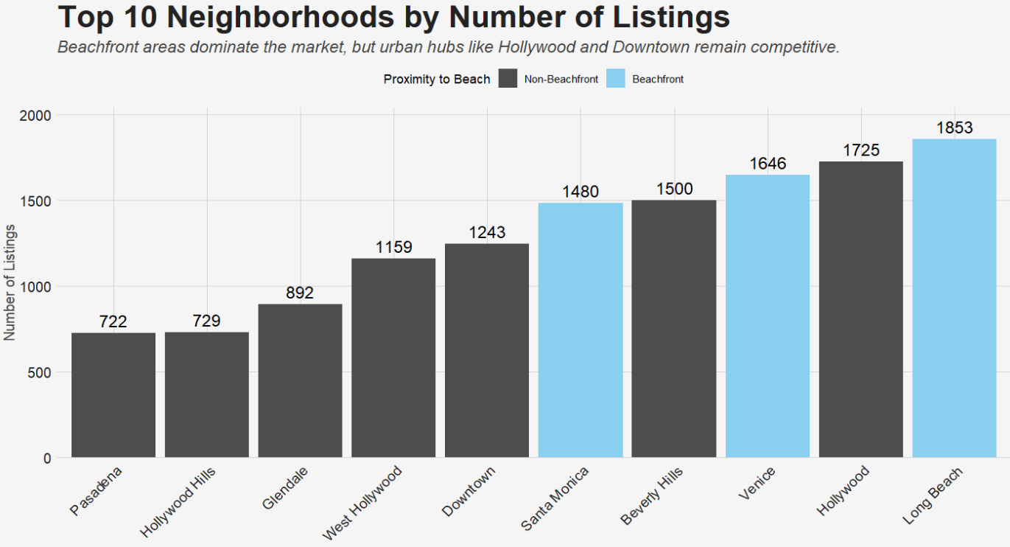
"Location, Location, Location": The Role of Neighbourhoods
INSIGHTS
Beachfront areas (e.g., Rancho Palos Verdes, Malibu) command premium prices due to their desirability and exclusivity.
Urban luxury neighborhoods like Beverly Hills and Bel-Air achieve competitive mid-tier pricing without direct coastal access, likely driven by prestige and amenities.
Southeast Antelope Valley offers the lowest average nightly price, positioning it as a value-oriented option.
IMPLICATIONS
Maximize revenue in beachfront markets by targeting luxury travelers and emphasizing exclusivity.
Focus marketing efforts on urban luxury areas to attract guests seeking premium experiences without beachfront access.
Promote budget-friendly destinations like Southeast Antelope Valley as ideal for long-term stays or cost-conscious travellers.
Notes:
Carolina island is infactalso a coastal area

Slide 5
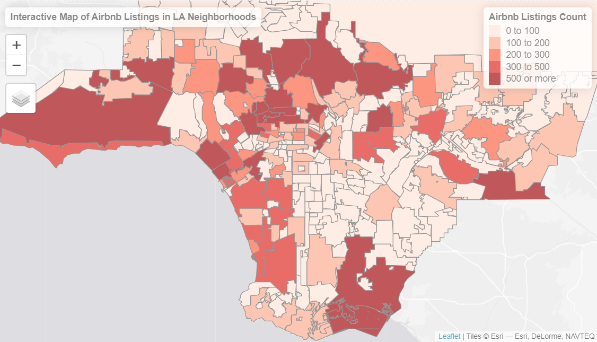
Interactive Map: Airbnb Listings in LA Neighborhoods
Density Trends:
• Popular neighborhoods like Hollywood, Venice Beach, and Downtown Los Angeles have the highest density of Airbnb listings
• Coastal areas (e.g., Santa Monica and Venice) see a clustering of premium listings, likely due to their scenic views and tourist attractions
Neighborhood Popularity:
• Hollywood listings account for approximately 15% of the total Airbnb properties in LA, driven by its iconic landmarks and nightlife
• Suburban areas like Pasadena and Sherman Oaks show fewer listings but higher guest satisfaction ratings, appealing to travelers seeking tranquility
Insights:
• Hosts in high-density areas should focus on differentiation (e.g., unique themes, personalized services) to stand out
• Less saturated neighborhoods offer opportunities for new hosts to enter the market, especially if they target niche audiences such as families or remote workers
Hollywood Boulevard is a magnet for Airbnb guests, with some properties marketing their proximity to the Walk of Fame. One listing even highlights being “steps away from Brad Pitt’s star”!

Slide 6
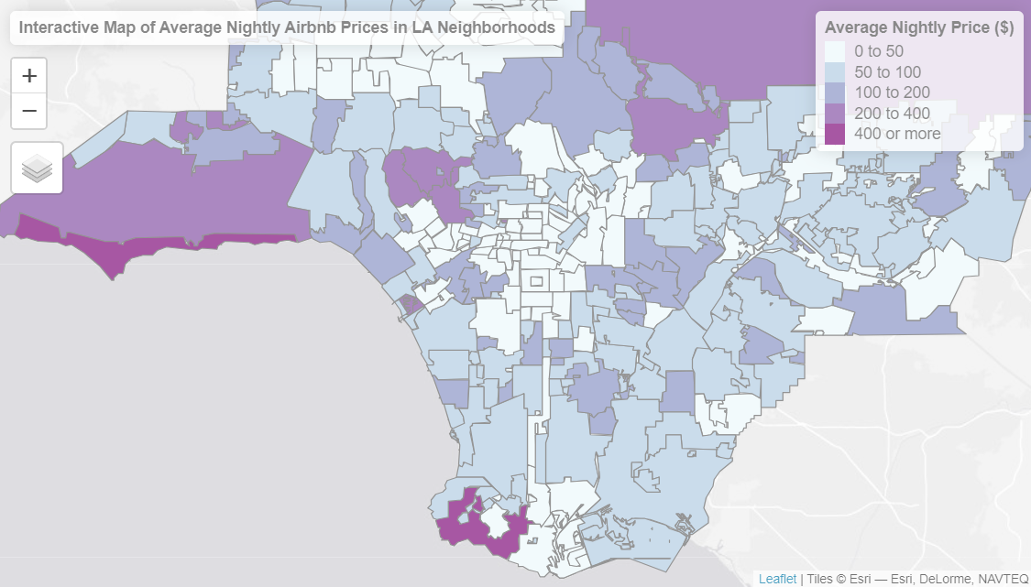
Interactive Map: Average Nightly Airbnb Prices in LA Neighborhoods
Price Clusters:
• High-end neighborhoods like Beverly Hills and Malibu have the most expensive average nightly rates, often exceeding $500
• More budget-friendly options are clustered around Downtown LA and Koreatown, with average prices ranging between $100 and $150
Price Variance:
• Coastal properties command a premium due to their views and proximity to beaches, with Venice Beach averaging $250 per night
• Inland neighborhoods with cultural attractions (e.g., Echo Park, Silver Lake) offer competitive pricing while still maintaining strong occupancy rates
Insights:
• Pricing optimization should consider proximity to attractions, competition within the neighborhood, and seasonality
• Budget-conscious travelers can find great deals in emerging neighborhoods like Highland Park, which combines affordability with trendy cultural spots
The most expensive locations are typically beachfront, with a notable exception of Beverly Hills. Notice that a lot of central neighborhoods with high density listings are actually quite cheap!

Slide 7
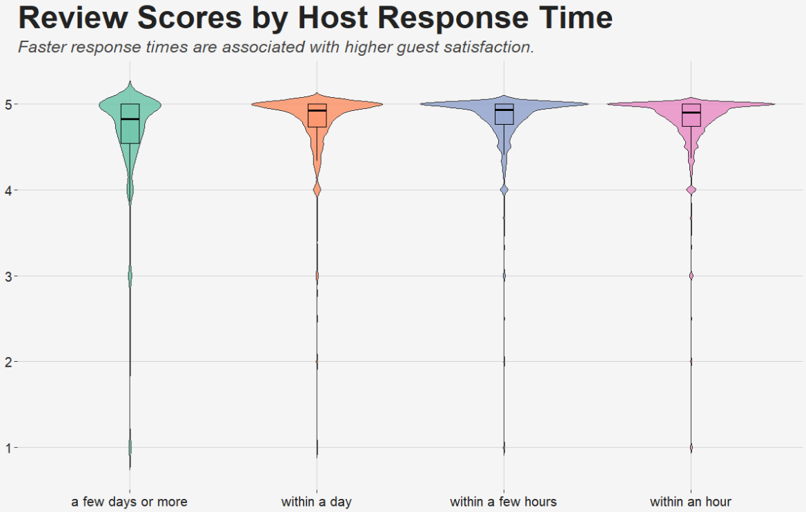
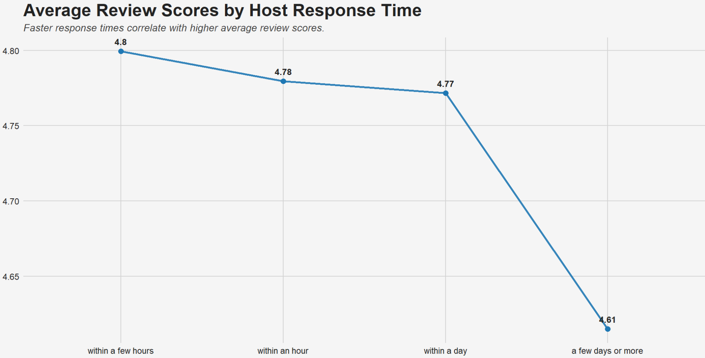
"Host with the Most": The Impact of Host Behaviour
Fast response times signal reliability and increase guest satisfaction, encouraging repeat bookings and positive reviews.
Both qualitative (violin plot) and quantitative (trend analysis) insights underscore the link between responsiveness and guest experience.
Hosts responding "within a few hours" achieve the highest average review score of 4.8
A 1-day delay leads to a noticeable drop to 4.77, while responding "a few days or more" further decreases the score to 4.61.

Slide 8
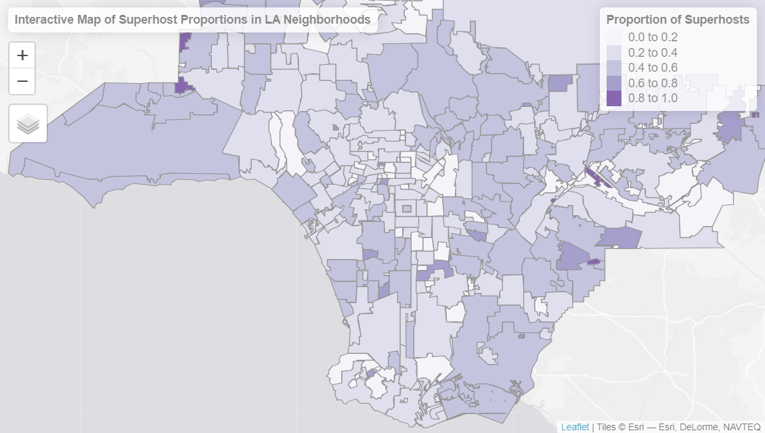
An Airbnb Superhost is a designation awarded to hosts who consistently provide exceptional hospitality and meets the following criteria
High ratings: Maintain an average rating of at least 4.8 stars based on guest reviews.
Low cancellation rates: Less than 1% cancellation rate without valid reasons.
High responsiveness: Respond to 90% or more of guest messages within 24 hours.
Minimum hosting activity: Complete at least 10 stays or 3 reservations with a total of at least 100 nights in the past year.
Notes:
Not a lot of superhosts in some of the more popular central areas like

Slide 9
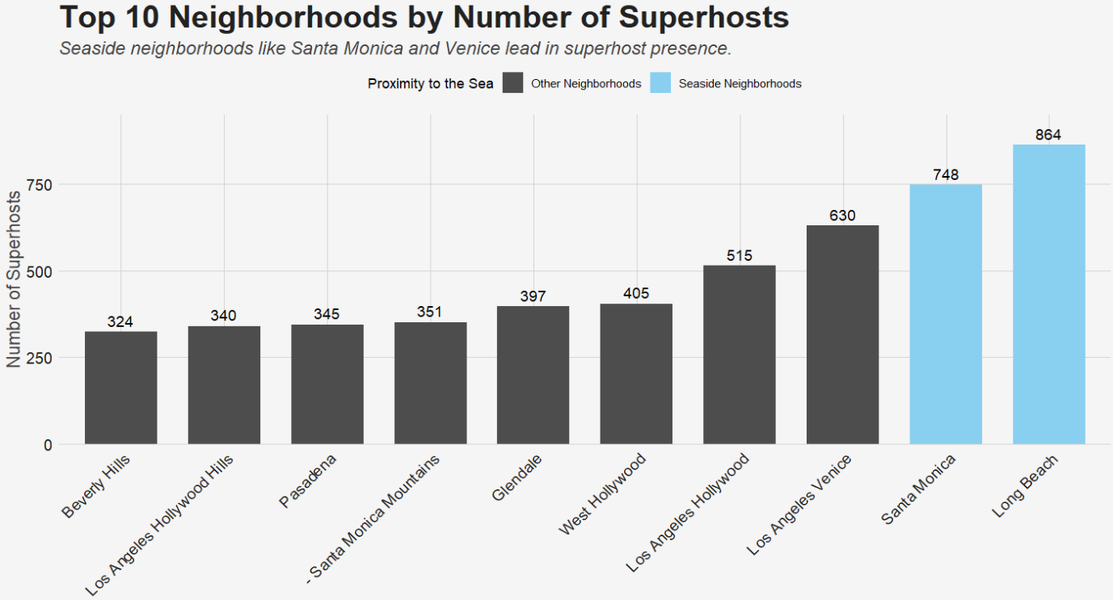
"Host with the Most": The Impact of Host Behaviour
Analyzing Superhost Trends
KEY CONSIDERATIONS:
Achieving and maintaining Superhost status on Airbnb significantly
enhances a host's performance metrics:
Increased Earnings: Superhosts earn, on average, 64% more in
booking revenue compared to non-Superhosts
Higher Guest Satisfaction: Superhosts maintain an average
rating of 4.8 or higher, reflecting consistent guest satisfaction
Enhanced Visibility: Superhosts experience an 11% increase in
overall impressions, indicating improved visibility
STRATEGIC TAKEAWAYS
Underserved Areas:
Regions with low Superhost density, as seen in lighter-colored
neighborhoods on the map, may provide opportunities for new hosts
to stand out and capture unmet demand.
Success in these areas still hinges on delivering quality service
to achieve Superhost status.
Superhost Goals:
Prioritize meeting Superhost criteria: high ratings, low cancellation
rates, and responsiveness

Slide 10
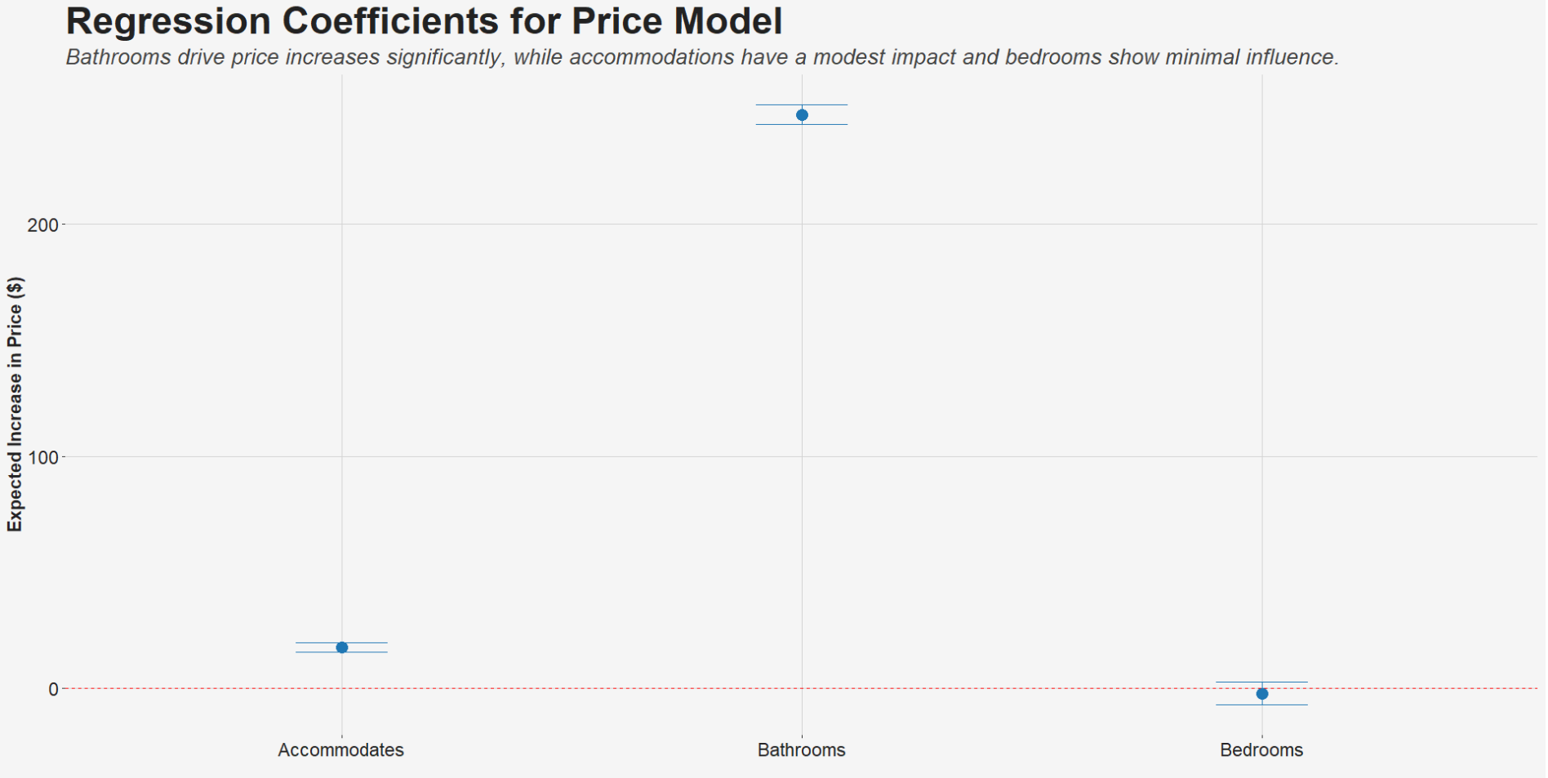
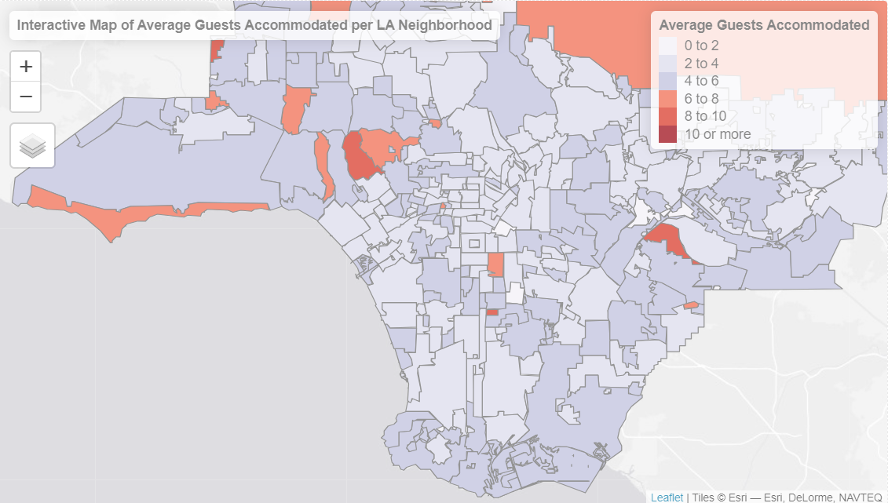
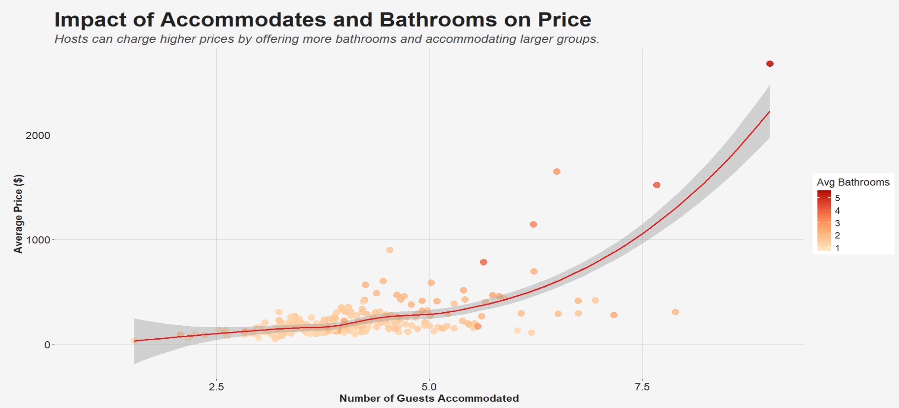
"The Price is Right": Balancing Affordability and Quality
Accommodations and Bathrooms Drive Pricing:
Listings accommodating larger groups and offering more bathrooms command significantly higher prices, as shown by the regression and scatterplot trends.
Bathrooms Have the Strongest Impact:
Regression analysis reveals bathrooms are the biggest driver of price increases, while accommodations show moderate impact and bedrooms minimal influence.
Neighborhood Variation:
Map analysis highlights areas with higher guest accommodation capacity, such as certain coastal and suburban regions, which align with higher pricing potential.

Slide 11
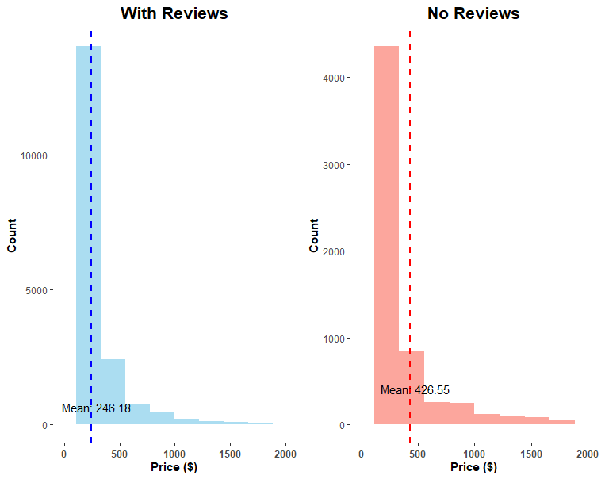
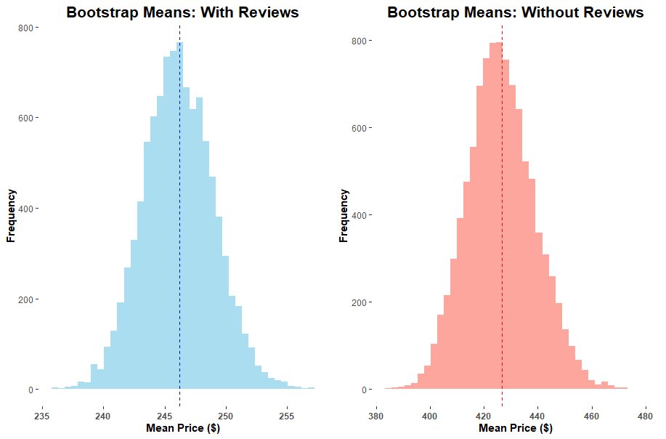
Does the absence of reviews affect price significantly?
Surprisingly, the mean for sample of listings without review is bigger than the mean of sample with reviews. Let us see if this is statistically significant
This means that listings without reviews are, on average, $180 more expensive than listings with reviews

Slide 12
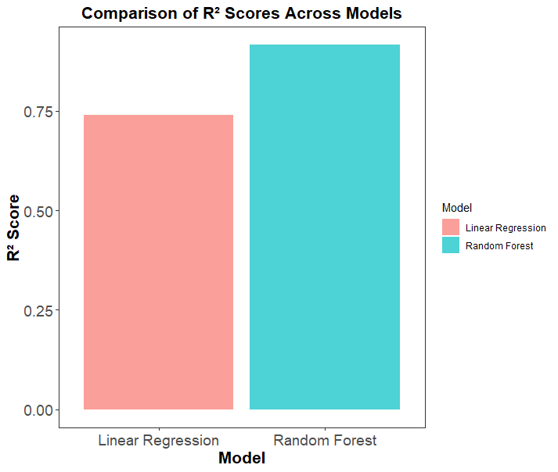
Model Performance Comparison for Airbnb Price Prediction
R²: Explains the proportion of variance in the target variable
MAE: Measures average absolute prediction errors
RMSE: Penalizes large errors, emphasizing the impact of outliers
Model | MAE | RMSE | R2
Random Forest | 0.1733 | 0.2931 | 0.9155
Linear Regression | 0.3862 | 0.5147 | 0.7394

Slide 13
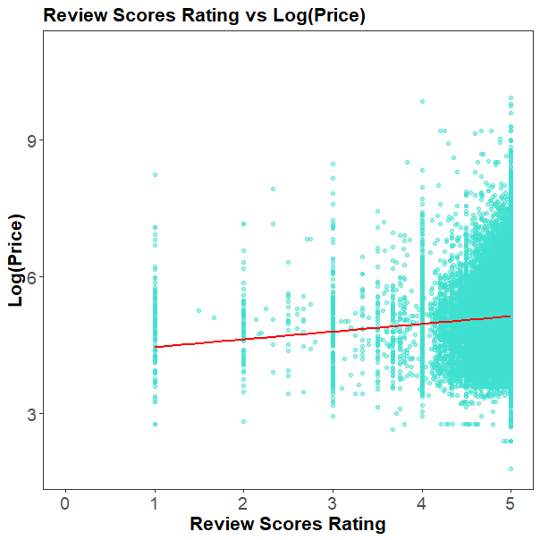
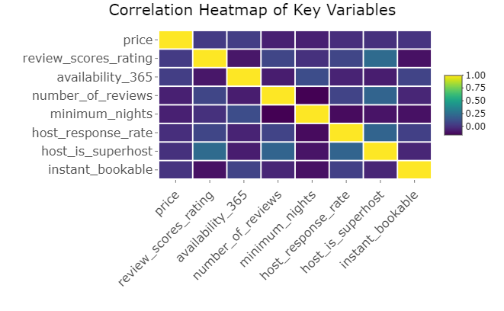
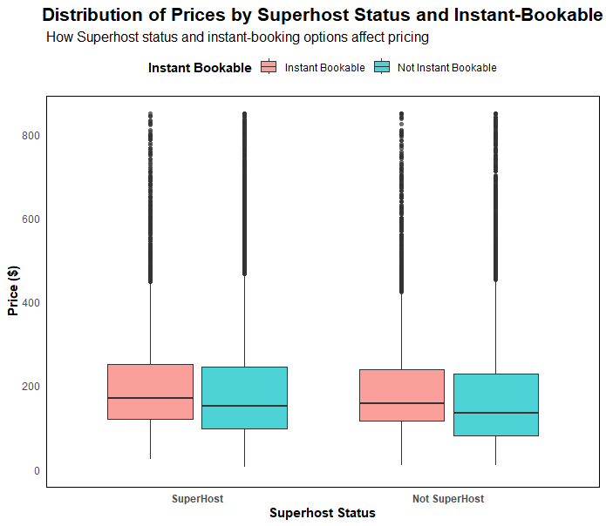
Relationships Between Key Variables
While review scores show a slight positive trend, other factors like instant bookable status have minimal direct impact on pricing.

Slide 14
Key Insights and Takeaways
Location
Coastal areas like Santa Monica and Long Beach exhibit a "coastal premium" effect, commanding higher prices and hosting a higher density of superhosts
Proximity to public transport and landmarks boosts booking rates by 25-30%
Host Strategies Matter
Superhost Status: While superhosts offer better guest experiences, their pricing isn't necessarily higher, suggesting their appeal lies in reliability rather than cost
Response Times: Hosts responding within an hour achieve the highest review scores (4.8+). Delayed responses significantly reduce satisfaction
Review Presence
Surprisingly, listings without reviews are, on average, $180 more expensive than those with reviews. This trend might stem from new, high-end listings skewing the data
Amenities and Property Features
Each additional bathroom exponentially increases price, particularly beyond 2.5 bathrooms
Accommodations for larger groups (7+ guests) perform better in central locations compared to peripheral areas

Slide 15
Host Recommendations
Prioritize rapid response times (under 1 hour) to maximize review scores
Consider property size relative to neighborhood averages when entering the market
Focus on location-specific amenities rather than competing solely on price
Implement instant booking to remain competitive, especially in high-density areas

